Slide 1
sdfsdsqdfqf sdfsdsqdfqf sdfsdsqdfqf
The battle of neighborhoods
Finding my little Paris in Manhattan

Slide 2
Goal
Finding neighborhoods in Manhattan that math the one I live in (Paris – 12e – Reuilly)

Slide 3
Type of data
GeoLocalization data
NewYork, 5 boroughs Manhattan 40 neighborhoods
CSV files
Paris, 20 neighborhoods
Table via opendata.fr
Categories (related to most visited spot in a given area)
163 categories in common
Gathered from Foursquares

Slide 4
Visualizing Neighborhoods
NewYork
Paris

Slide 5
Methodolody
Preparing the data
Loading
Cleasing (missing, null, type, non relevant…)
Defining structure (target dataframe)
Using KNN to split Manhattan into clusters
5 clusters
Checking meaning of clusters
Predict where Paris neighborhoods match Manhattan neighborhoods
Checking meaning of this matching

Slide 6
Results
5 clusters identified
Paris neighborhoods match 4 of them
1: [12, 14, 19]
2: [16]
3: [0, 1, 2, 3, 4, 6, 7, 8, 9, 10, 11, 13, 15, 17, 18]
4: [5]
All in all Paris is very close to cluster 3, as it is related to restaurants, wine bar/shop and bakery which makes sense.

Slide 7

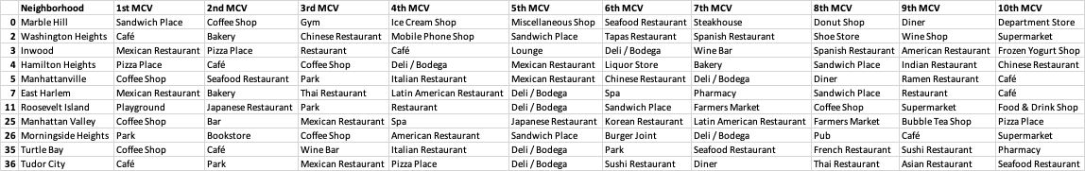
Conlusion
Paris neighborhoods has been match with Manhattan neighborhoods
Cluster to 2 is similar to the neighborhood I live in

